Slide 1
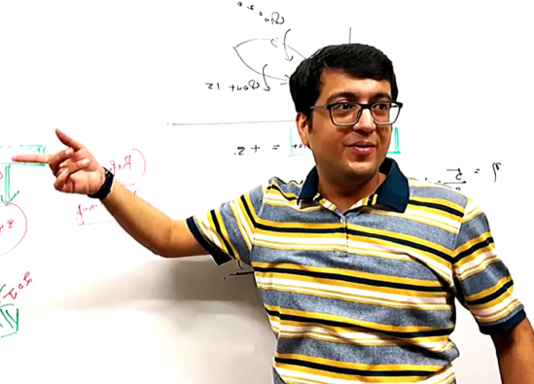
Vinay Sir
Physics

Slide 2
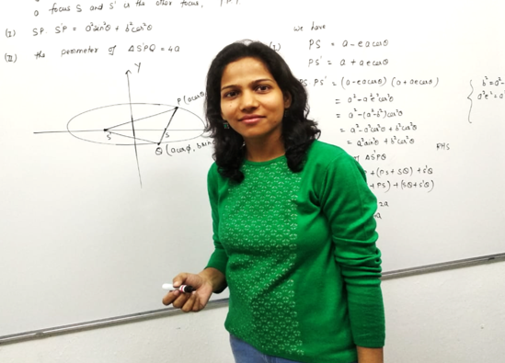
Nidhi ma’am
Maths

Slide 3
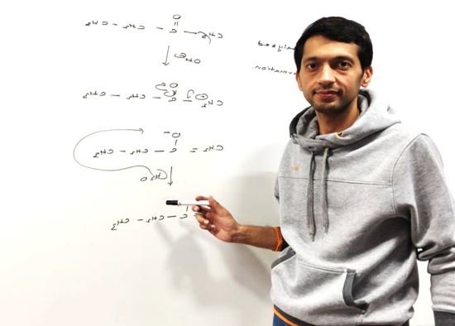
Vivek Sir
Chemistry

Slide 4
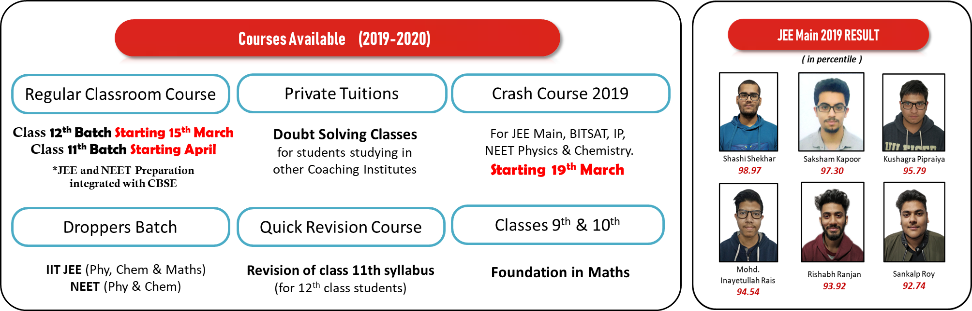

Slide 5
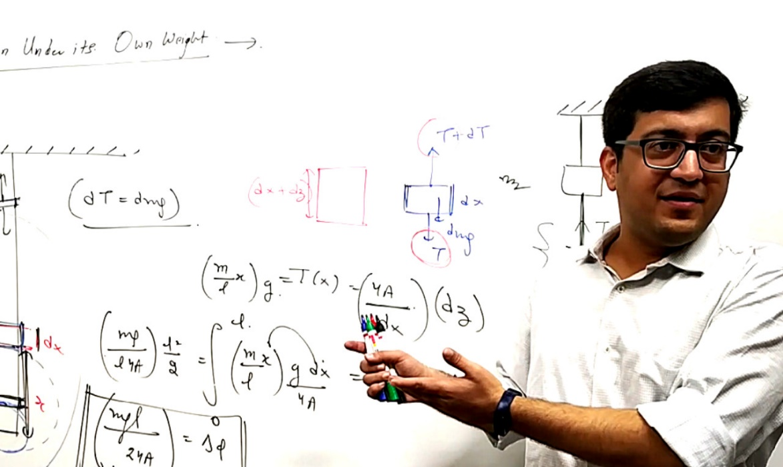
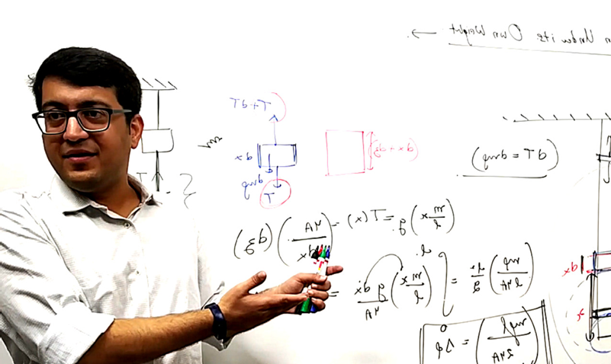

IIT- JEE & NEET
Complete Class 12th
PHYSICS
Video Lectures
Test papers
Lecture notes (pdf)
*Available on Laptop & App

Slide 6
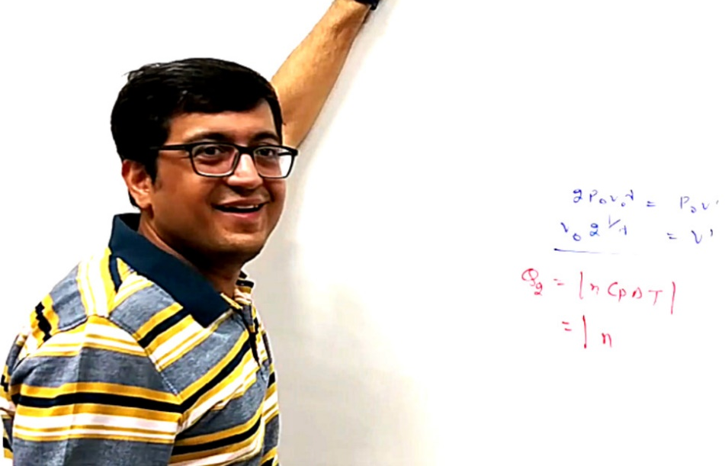
IIT- JEE & NEET
Complete Class 11th
PHYSICS
Video Lectures
Test papers
Lecture notes (pdf)
*Available on Laptop & App

Slide 7
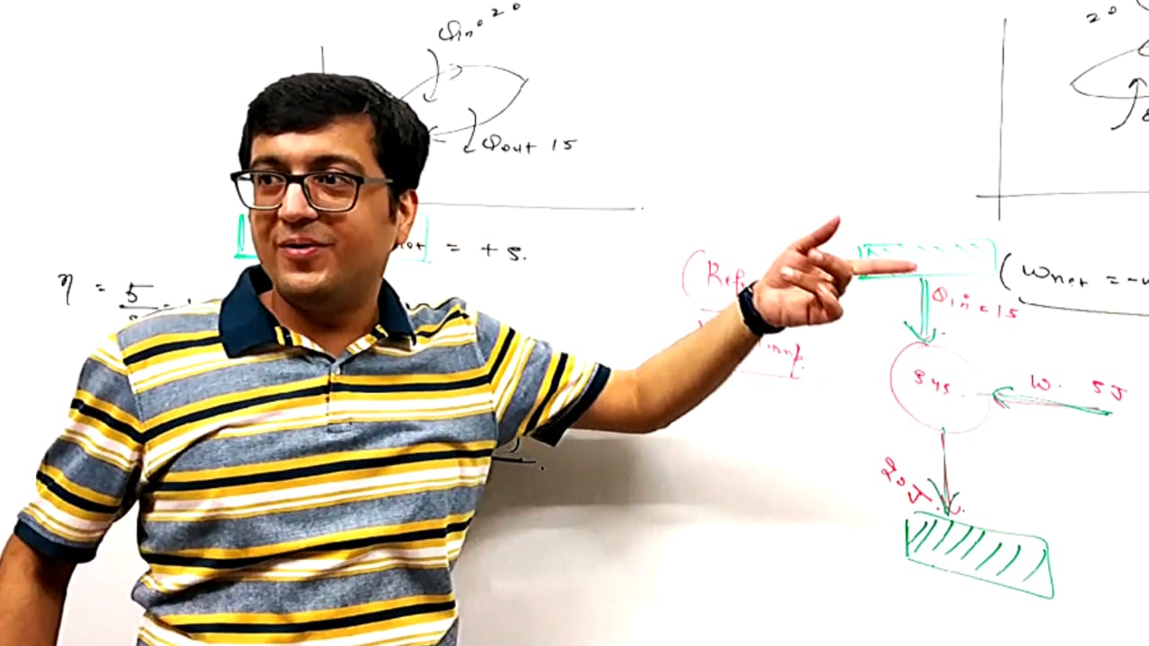
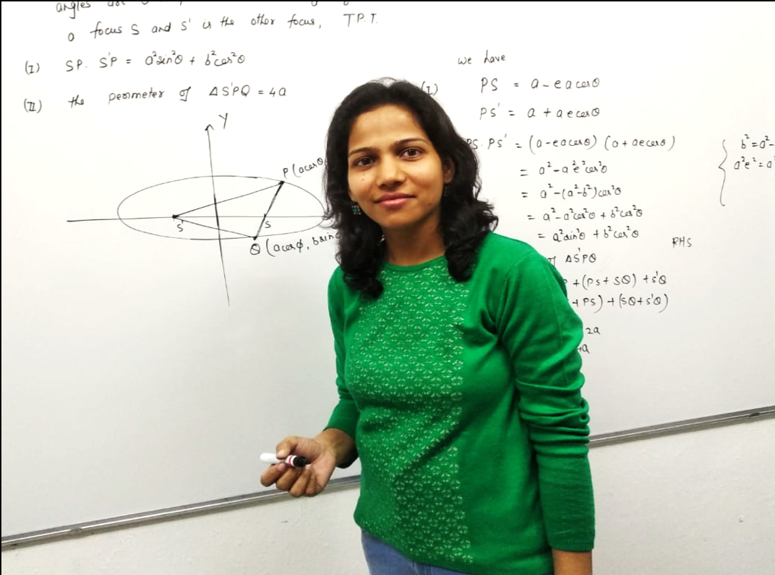
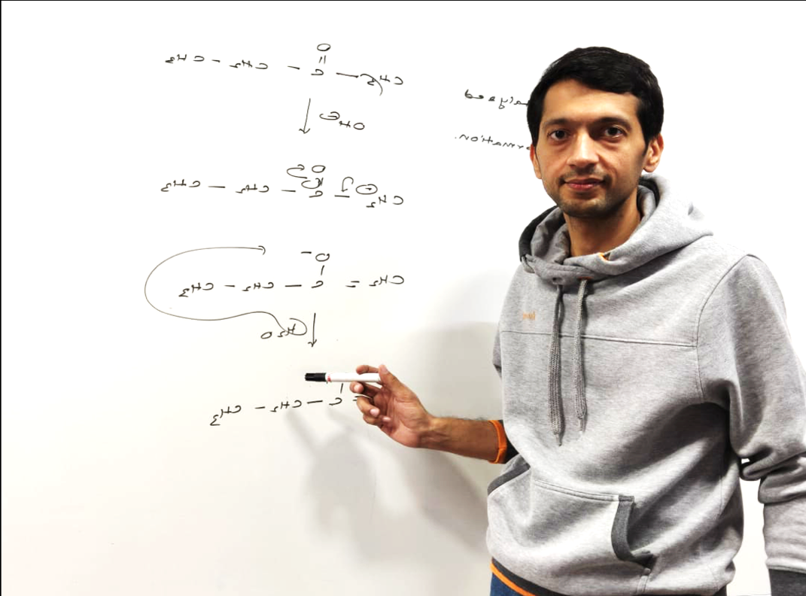

Slide 8

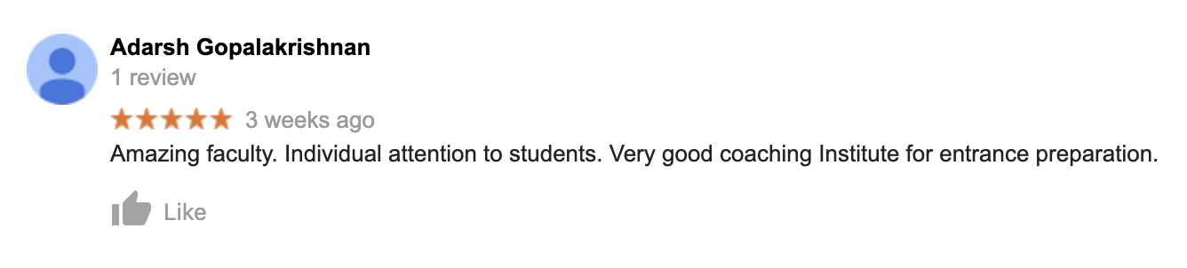

Slide 9
Admission Enquiry

Slide 10



Slide 11


VNV CLASSES
Coaching for
IIT-JEE & NEET

Slide 12
Batch size of 15 to 20
students ONLY !
No Gimmicks,
No hocus pocus, Success through Grit
and Hard Work
Coaching by IITians
Highly Experienced Faculty
Video lectures available for revision

Slide 14
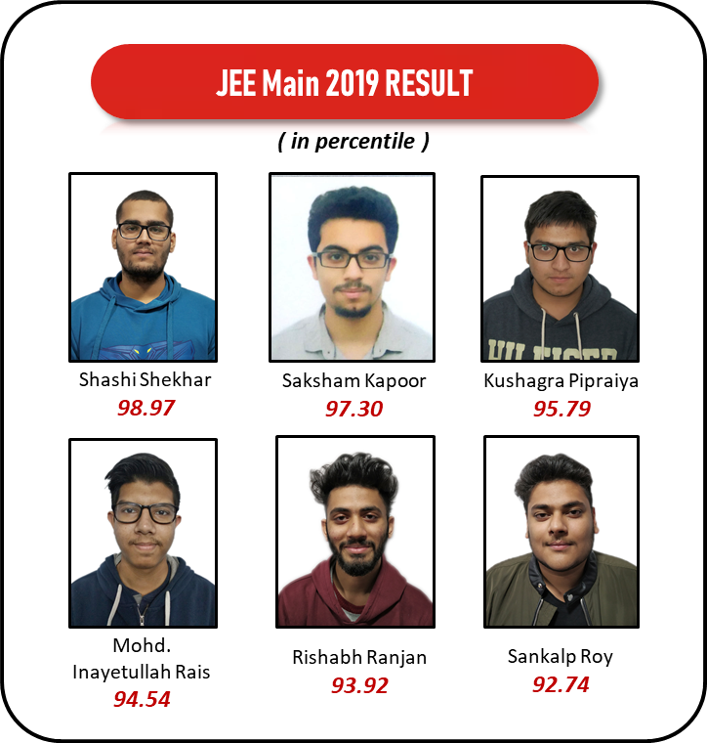
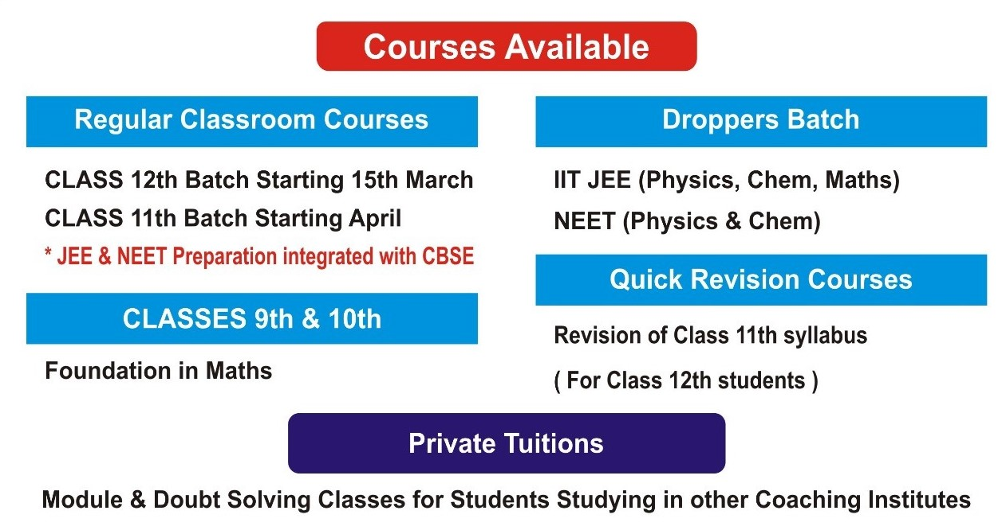
Courses Available (2019-2020)
Regular Classroom Course
Private Tuitions
Crash Course 2019
Class 12th Batch Starting 15th March
Class 11th Batch Starting April
*JEE and NEET Preparation
integrated with CBSE
Doubt Solving Classes
for students studying in
other Coaching Institutes
For JEE Main, BITSAT, IP,
NEET Physics & Chemistry.
Starting 19th March
Droppers Batch
Quick Revision Course
Classes 9th & 10th
IIT JEE (Phy, Chem & Maths)
NEET (Phy & Chem)
Revision of class 11th syllabus
(for 12th class students)
Foundation in Maths

Slide 15
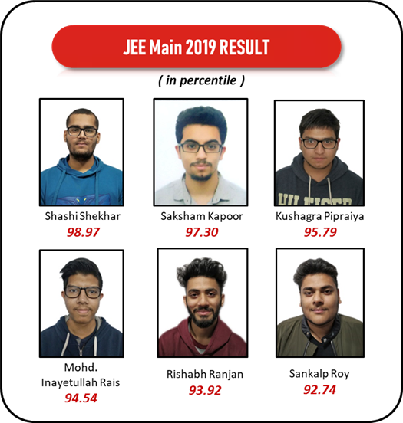
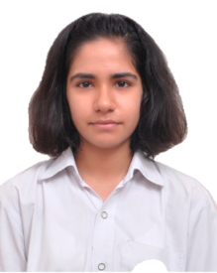
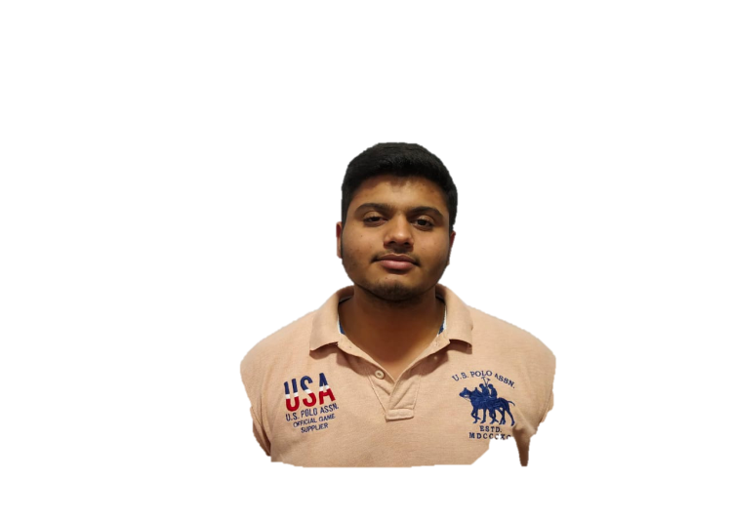
JEE Main 2019 Result
Courses Available (2019-2020)
percentile ( RANK )
Regular Classroom Course
Private Tuitions
Crash Course 2019
For Class 11th & 12th
*JEE and NEET Preparation
integrated with CBSE
Doubt Solving Classes
for students studying in
other Coaching Institutes
Shashi Shekhar
Saksham Kapoor
Kushagra Pipraiya
For JEE Main, BITSAT, IP,
NEET Physics & Chemistry.
99.40 (7070)
99.39 (7093)
97.77 (25244)
NEET 2019 Result
Droppers Batch
Quick Revision Course
Classes 9th & 10th
IIT JEE (Phy, Chem & Maths)
NEET (Phy & Chem)
Revision of class 11th syllabus
(for 12th class students)
Foundation in Maths
Mehak Singh
Deepanshu Yadav
Himanshu Yadav
Phy – 99.67%
Chem – 99.87%
Phy – 99.78%
Chem – 97.58%
Phy – 99.60%
Chem – 98.40%

Slide 16
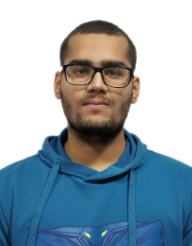
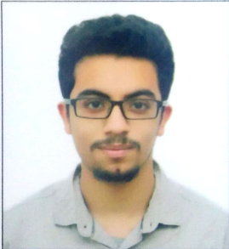
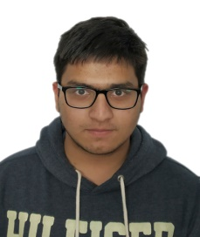




JEE Main 2019 RESULT
NEET 2019 RESULT
( percentile and rank)
Shashi Shekhar
99.40
Saksham Kapoor
99.39
Kushagra Pipraiya
97.77
Sankalp Roy
96.12
Mehak Singh
Deepanshu Yadav
Himanshu Yadav
Venus Goyal
Rank - 7070
Rank - 7093
Rank - 25244
Marks – 634/720
Phy – 99.67%
Chem – 99.87%
Marks – 578/720
Phy – 99.78%
Chem – 97.58%
Marks – 570/720
Phy – 99.60%
Chem – 98.40%
Marks – 543/720
Phy – 98.28%
Chem – 97.58%

Slide 17

JEE Main 2019 RESULT
NEET 2019 RESULT
Shashi Shekhar
Percentile - 99.40
Saksham Kapoor
Percentile - 99.39
Kushagra Pipraiya
Percentile – 97.77
Mehak Singh
Deepanshu Yadav
Himanshu Yadav
Rank - 7070
Rank - 7093
Rank - 25244
Marks – 634/720
Phy percentile – 99.67
Chem percentile – 99.87
Marks – 578/720
Phy percentile – 99.78
Chem percentile – 97.58
Marks – 570/720
Phy percentile – 99.60
Chem percentile – 98.40

Slide 18
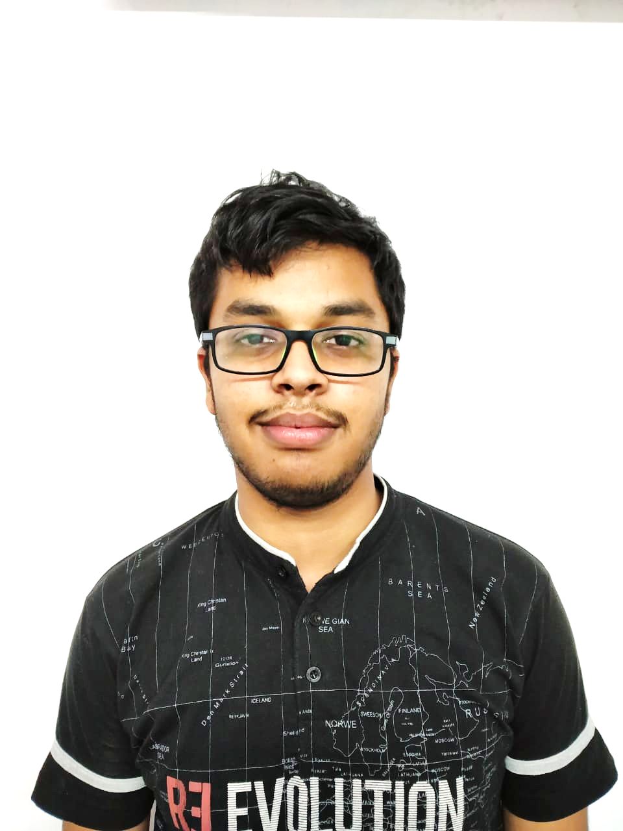
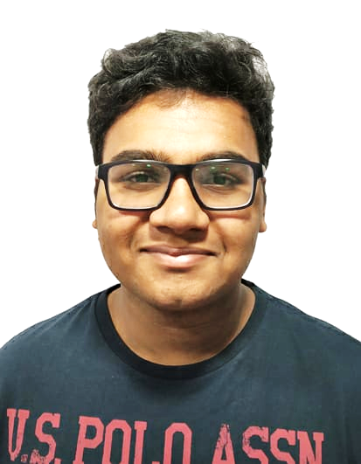
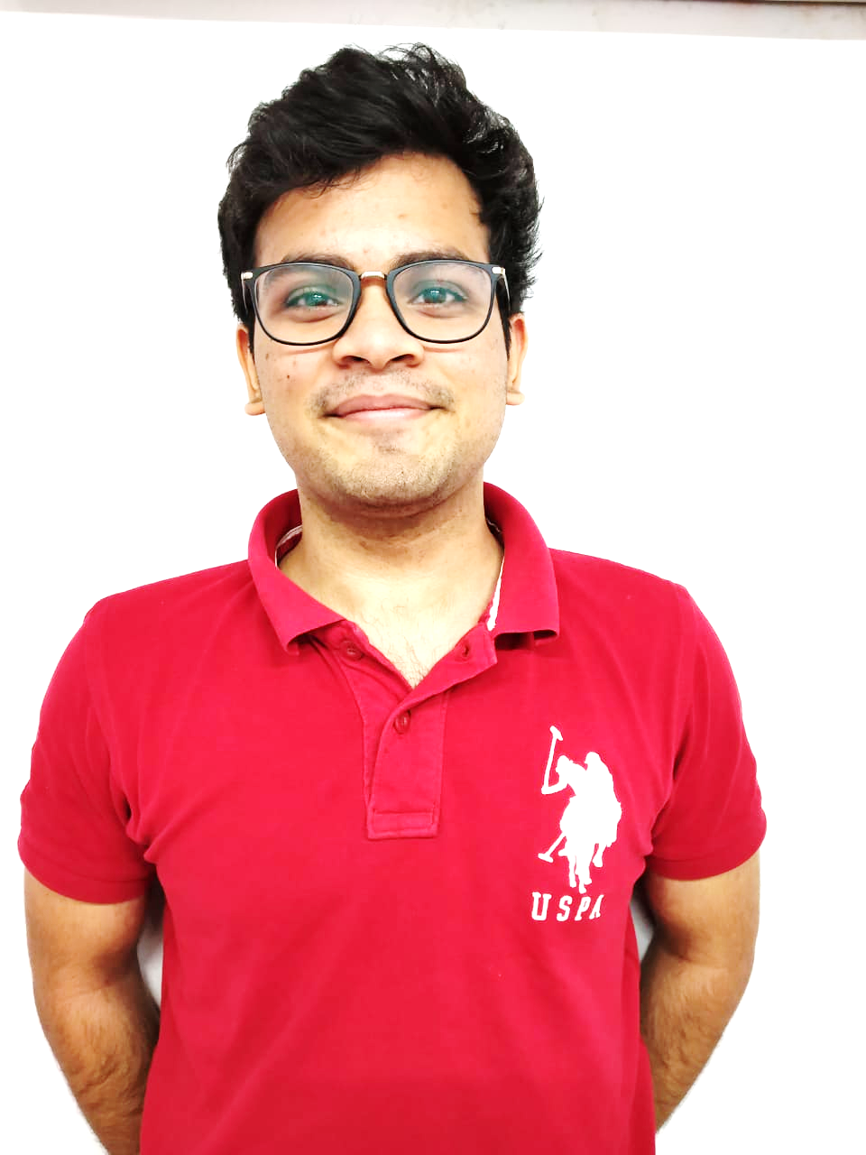
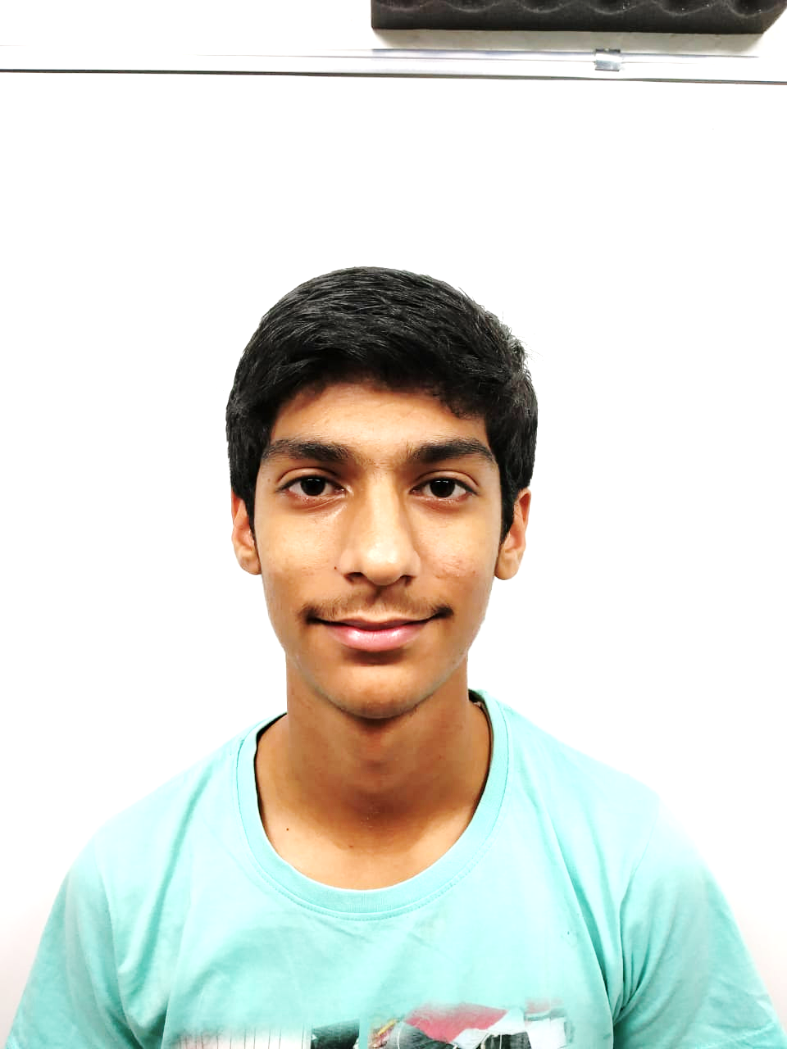
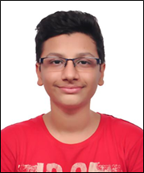
Harshul Gupta
Phy – 99.94
Chem – 99.35
Maths – 99.63
99.83 Percentile
Stubh Lal
Aayush Mohanty
Nishchay Mago
Harsh Pant
99.02
98.60
97.63
96.67
Percentile
Percentile
Percentile
Percentile

Slide 19
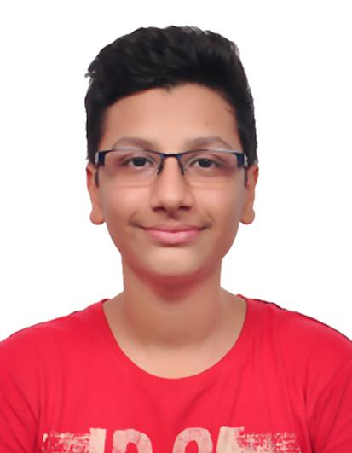
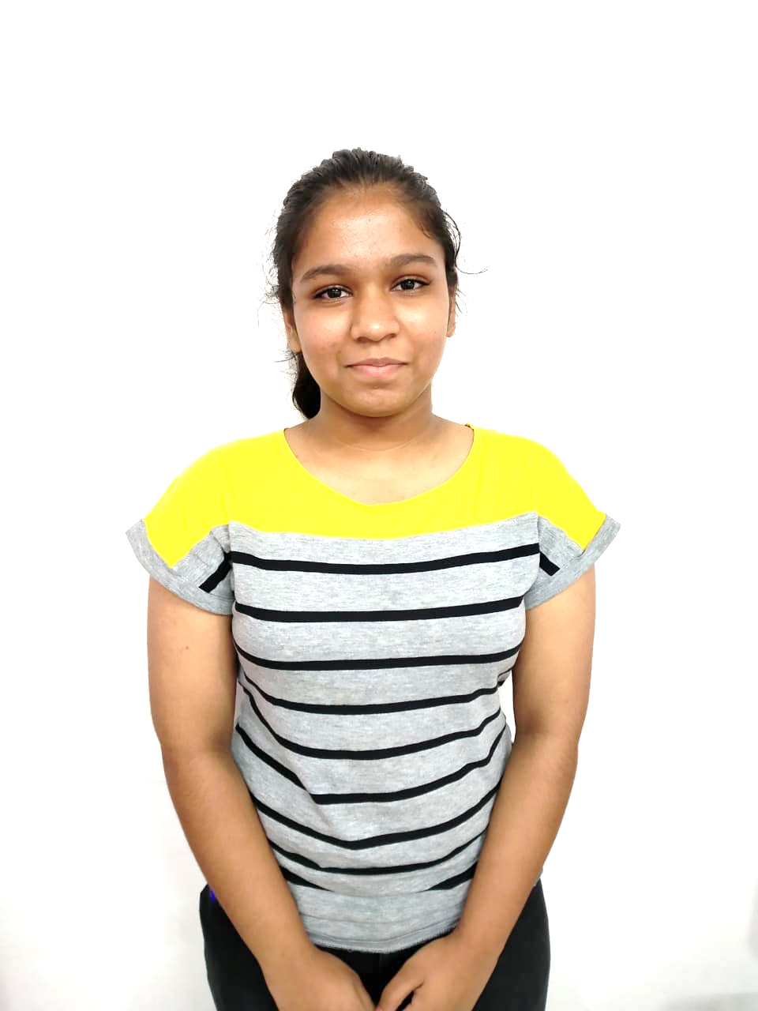
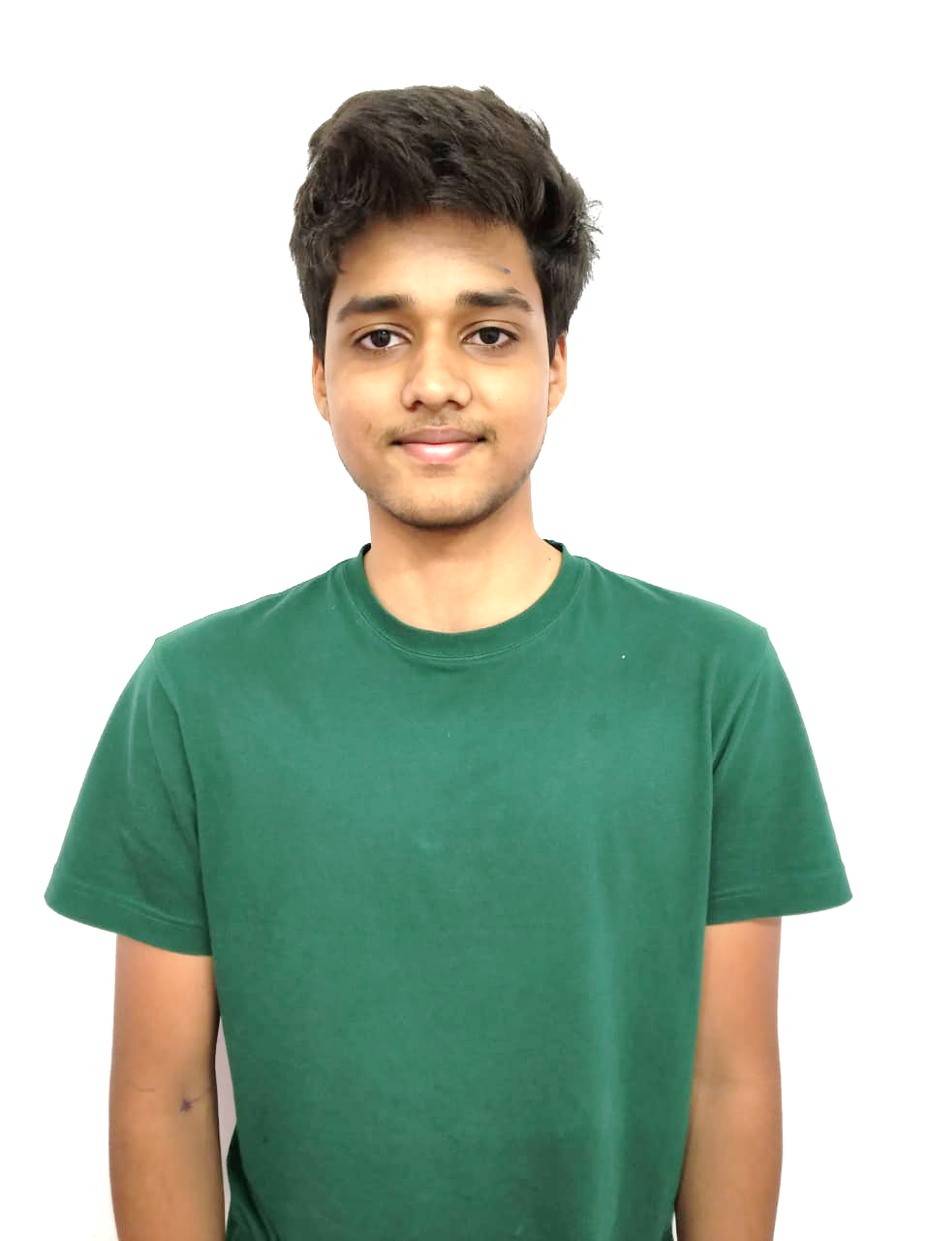
Stubh Lal
Aayush Mohanty
Nishchay Mago
99.02
98.60
97.63
Percentile
Percentile
Percentile
Harshul Gupta
99.83 Percentile
Phy – 99.94
Chem – 99.35
Maths – 99.63
Harsh Pant
Bhavya Gupta
Aadhar Jain
96.67
96.45
96.42
Percentile
Percentile
Percentile

Slide 20
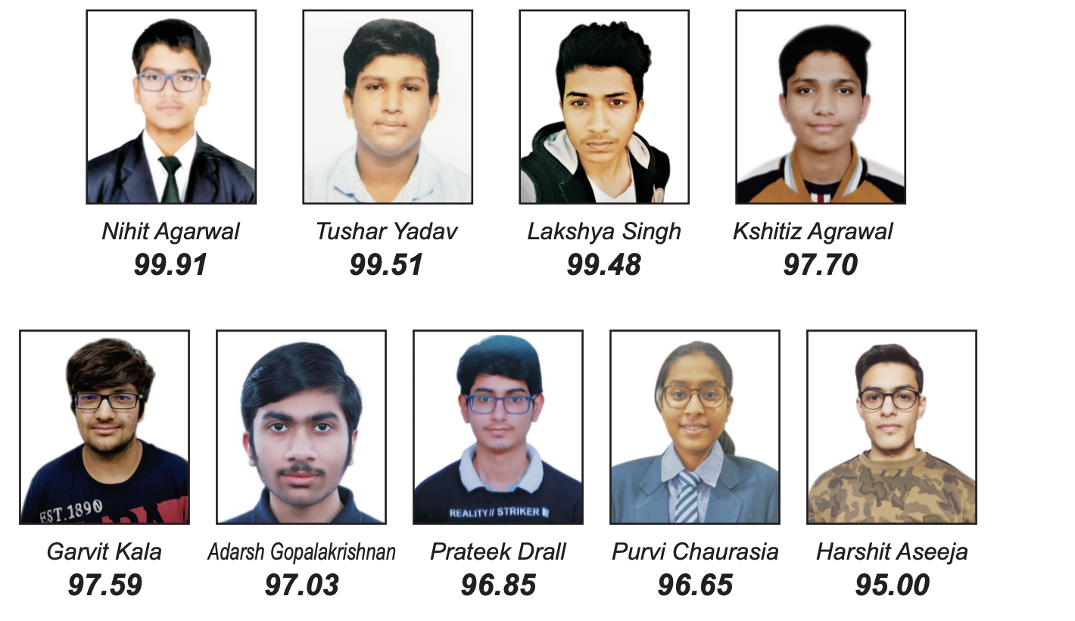
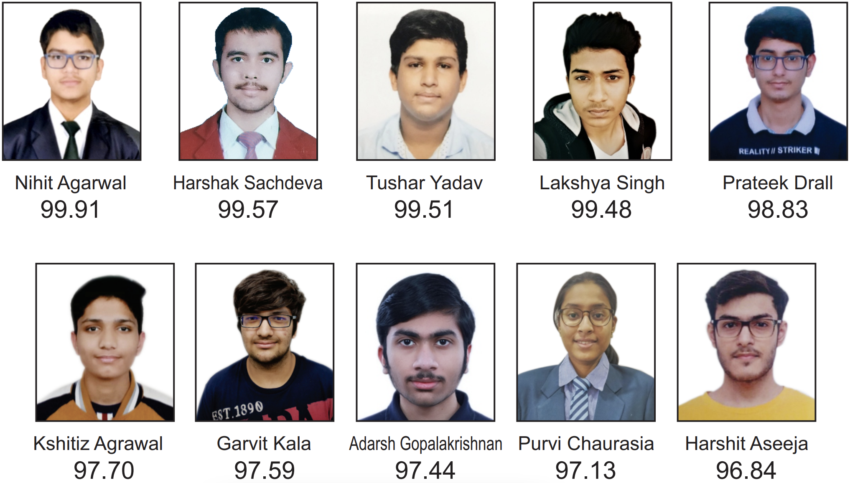
IIT JEE Main 2021 Result ( in percentile )
Nihit Agarwal
99.91
Harshak Sachdeva
99.57
Tushar Yadav 99.51
Lakshya Singh 99.48
Prateek Drall 98.83
Kshitiz Agrawal 97.70
Garvit Kala
97.59
Adarsh G. 97.44
Purvi Chaurasia 97.13
Harshit Aseeja 96.84
Notes:
q

Slide 21

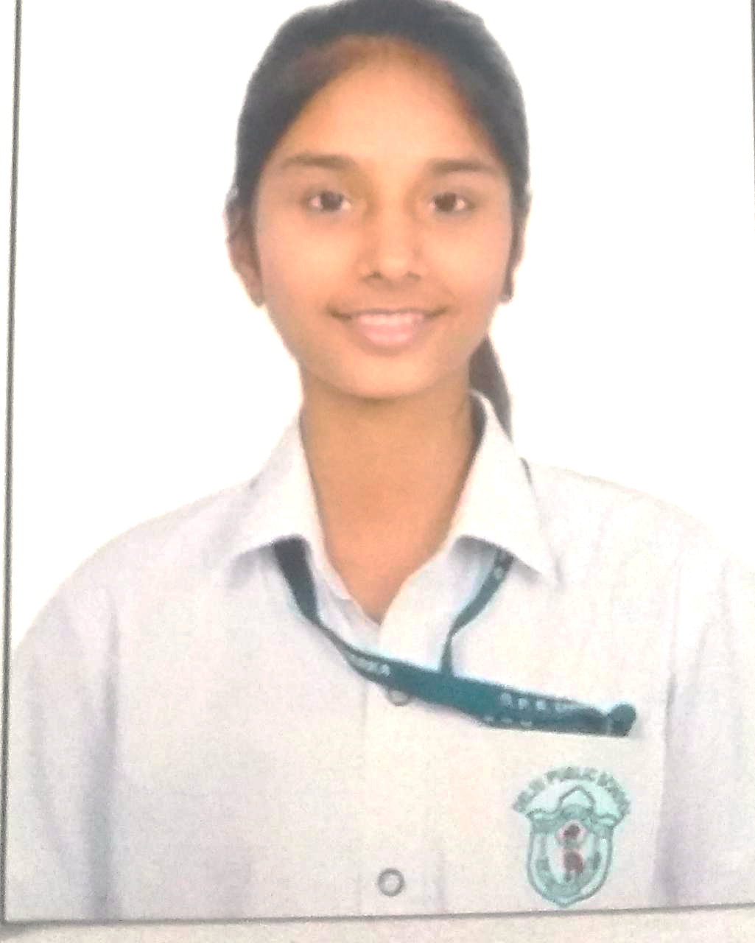
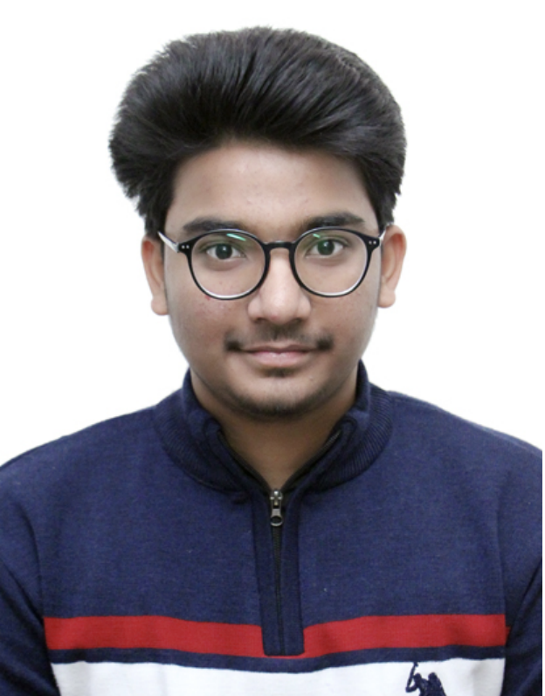
JEE Mains 2020 Result ( in percentile )
NEET 2020 Result
AIR - 882
Harshul Gupta
99.83
Nishchay Mago
99.07
Stubh Lal
99.02
Aayush Mohanty
98.60
Kanishk Goel
98.24
Vanshika Naithani
Nishant Kumar
Marks – 646/720
Phy – 99.56 percentile Chem – 99.04 percentile
Marks – 631/720
Phy – 99.10 percentile Chem – 99.18 percentile
Uditansh Bhandari
98.18
Harsh Pant
96.67
Bhavya Gupta
96.45
Aadhar Jain
96.42

Slide 22

JEE Mains 2020 Result ( in percentile )
NEET 2020 Result
Harshul Gupta
99.83
Nishchay Mago
99.07
Stubh Lal
99.02
Aayush Mohanty
98.60
Kanishk Goel
98.24
Uditansh Bhandari
98.18
Vanshika Naithani
Nishant Kumar
Marks – 646/720
Phy – 99.56 percentile Chem – 99.04 percentile
Marks – 631/720
Phy – 99.10 percentile Chem – 99.18 percentile
AIR - 882

Slide 23
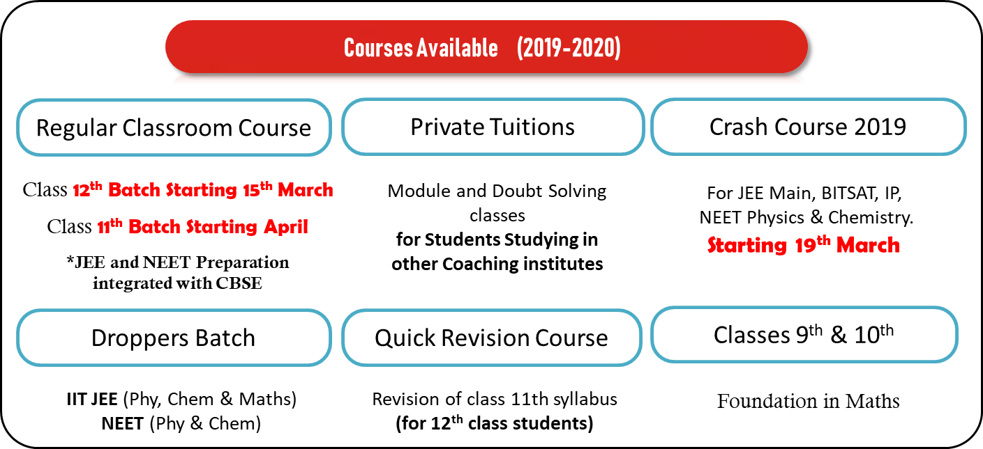
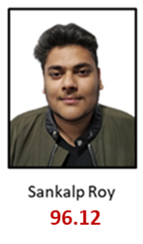
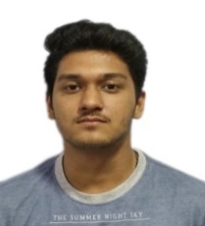

percentile ( RANK )
99.40 (7070)
99.39 (7093)
97.77 (25244)
Uditansh Bhandari
95.11
96.12

Slide 24
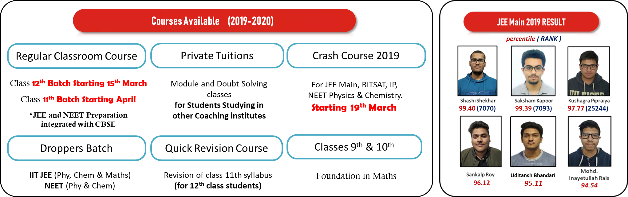

Slide 25
percentile ( RANK )
99.40 (7070)
99.39 (7093)
97.77 (25244)
96.12

Slide 26
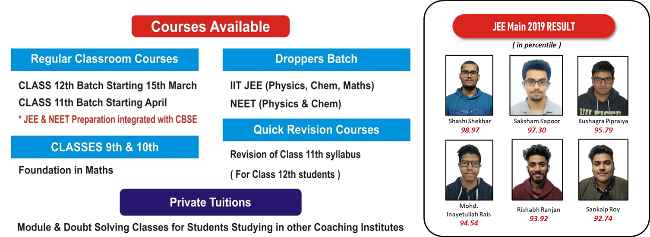

Slide 27
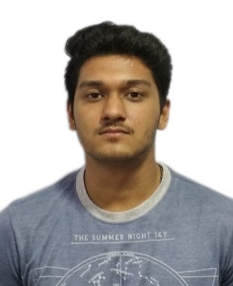
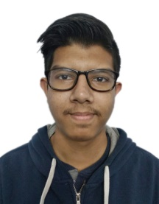
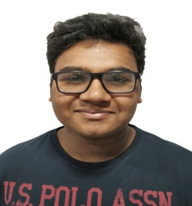

JEE Main 2019 RESULT
( percentile and rank)
Shashi Shekhar
99.40
Saksham Kapoor
99.39
Kushagra Pipraiya
97.77
Sankalp Roy
96.12
Uditansh Bhandari
95.11
Mohd. Inayetullah Rais
94.54
Stubh Lal
92.16
Rishabh Ranjan
93.92
Rank - 7070
Rank - 7093
Rank - 25244

Slide 28
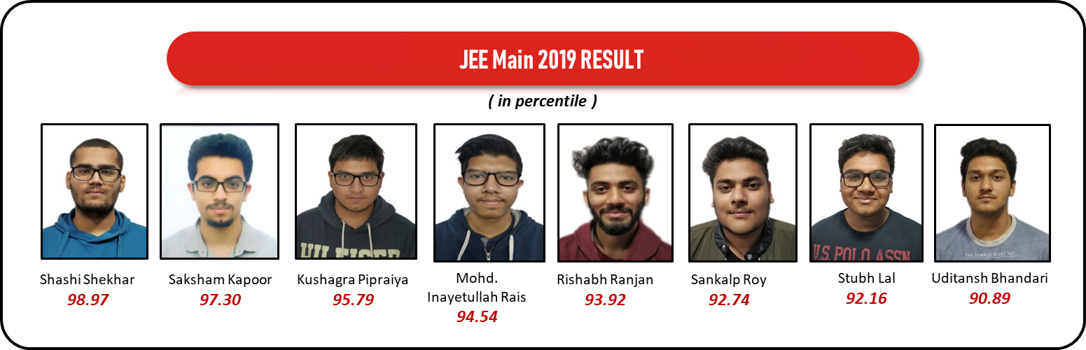

Slide 29


Slide 30
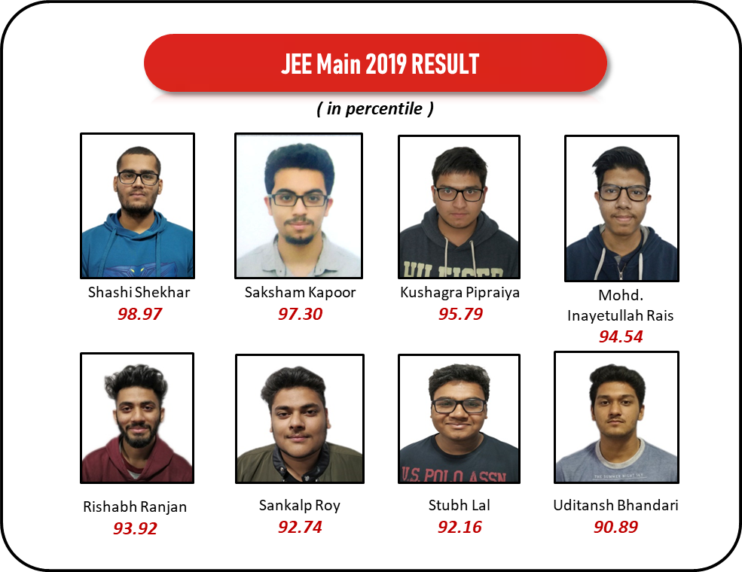
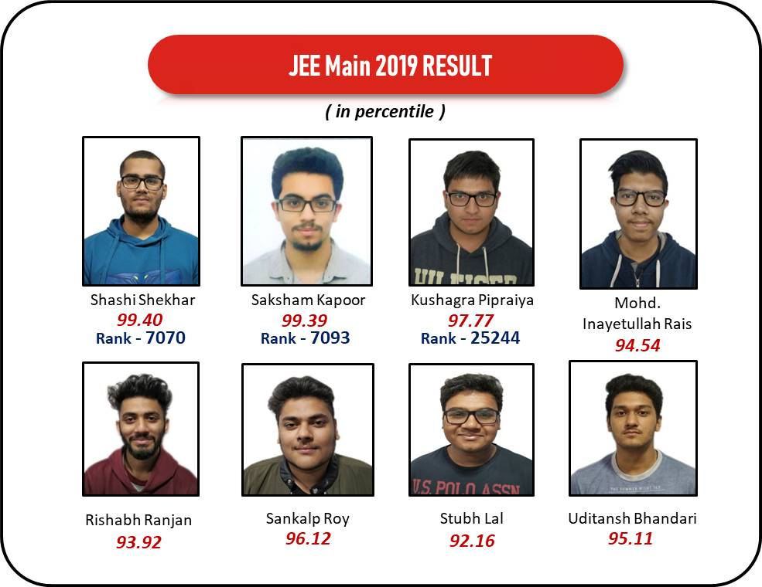
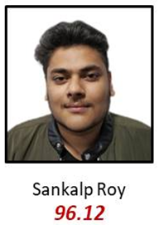

99.40
99.39
97.77
Rank - 7070
Rank - 7093
Rank - 25244
96.12
95.11

Slide 32

MATHEMATICS
REVISION VIDEOS

Slide 33


Slide 34

MATHEMATICS
REVISION VIDEOS

Slide 35


Slide 36
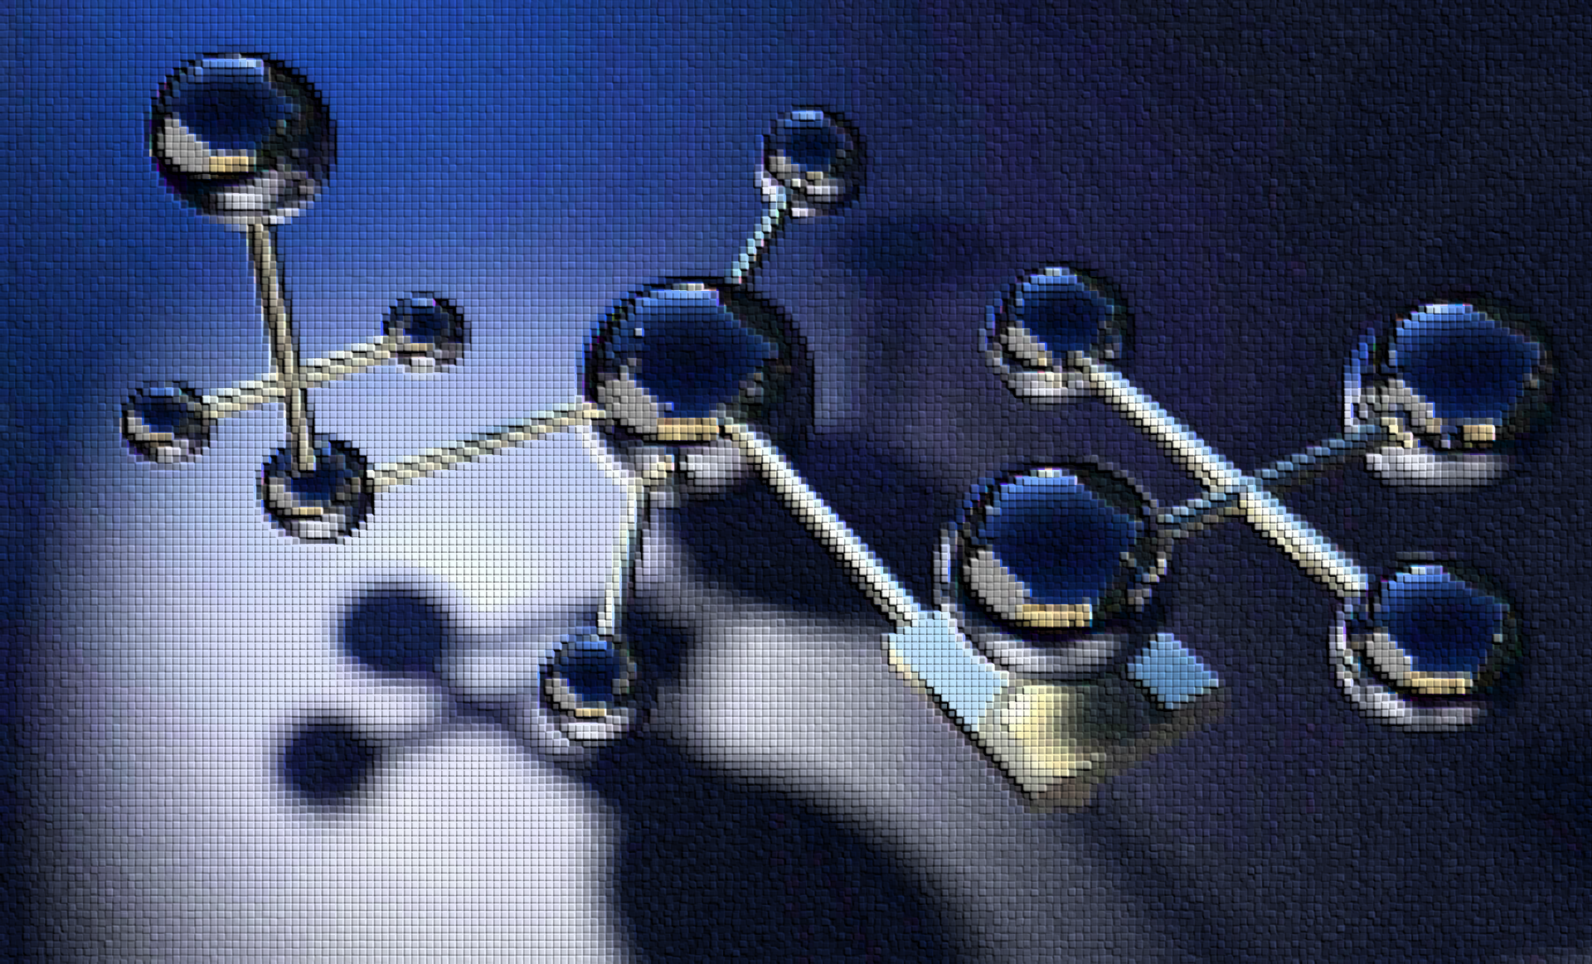
CHEMISTRY
REVISION VIDEOS

Slide 37
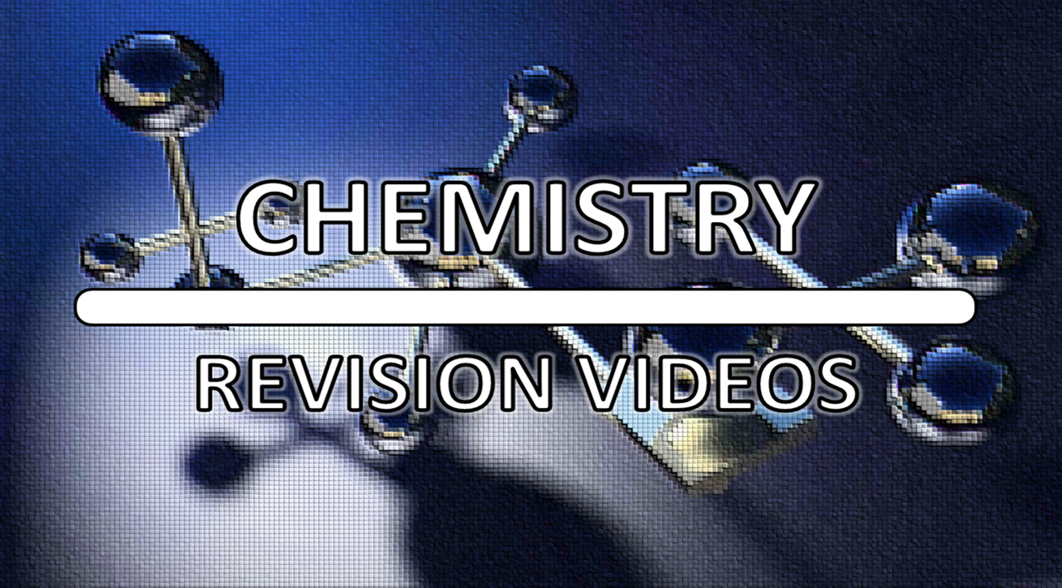

Slide 38

PHYSICS
REVISION VIDEOS

Slide 39


Slide 41
Above 90% success rate in JEE Mains 2019

